Slide 1
In 1970, Cornell hockey put their name in the history books as the only team to go undefeated for a whole season and win the national title.

Slide 2
Though they forever left their mark on the sport, in the 55 years since their championship win, a lot has changed.

Slide 3
As we journey further into the future, it becomes more difficult to remember exactly what this team accomplished. Their historic success is hidden in half-a-century-year-old newspapers and the stadiums that were played in are getting demolished.

Slide 4
There was a commemoration in 2020 for the 50 year anniversary of the team’s historic season, but there likely won’t be another event like that in the near future.

Slide 5
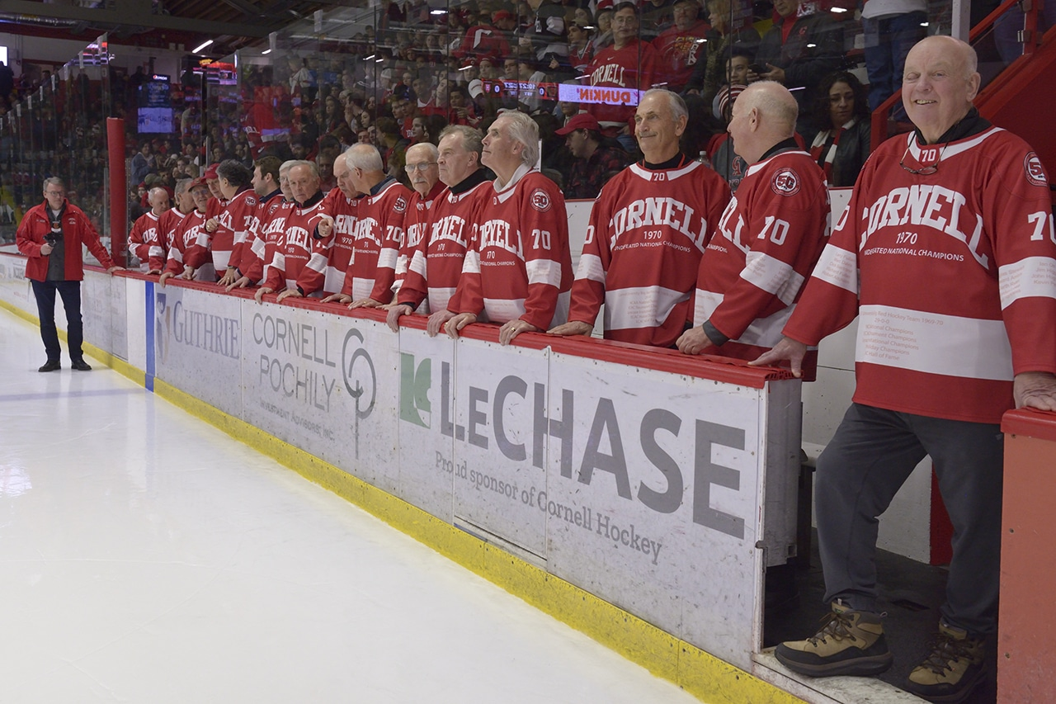

Slide 6
It's disheartening to see such an incredible accomplishment slip away from the public eye, but you can understand why. For this team, their story was written on the ice, in the stadiums.

Slide 7
Fifty-five years later, the architecture of their season has changed. Every stadium they visited is undeniably different.

Slide 8
Cornell played their first few games at home, in Lynah Rink. Three dominant victories over Western Ontario (8-2), Guelph (4-1), and Rensselaer (8-2) foreshadow the season to come.

Slide 9
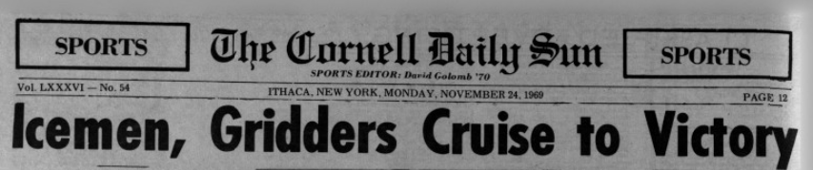

Slide 10
Lynah’s changed a bit since 1970, with renovations to the ice and seating arrangements happening during the mid 2000s.

Slide 11
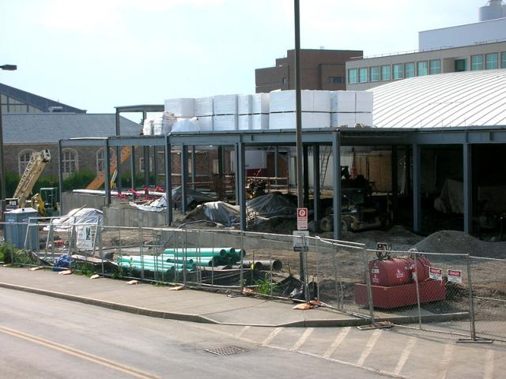

Slide 12
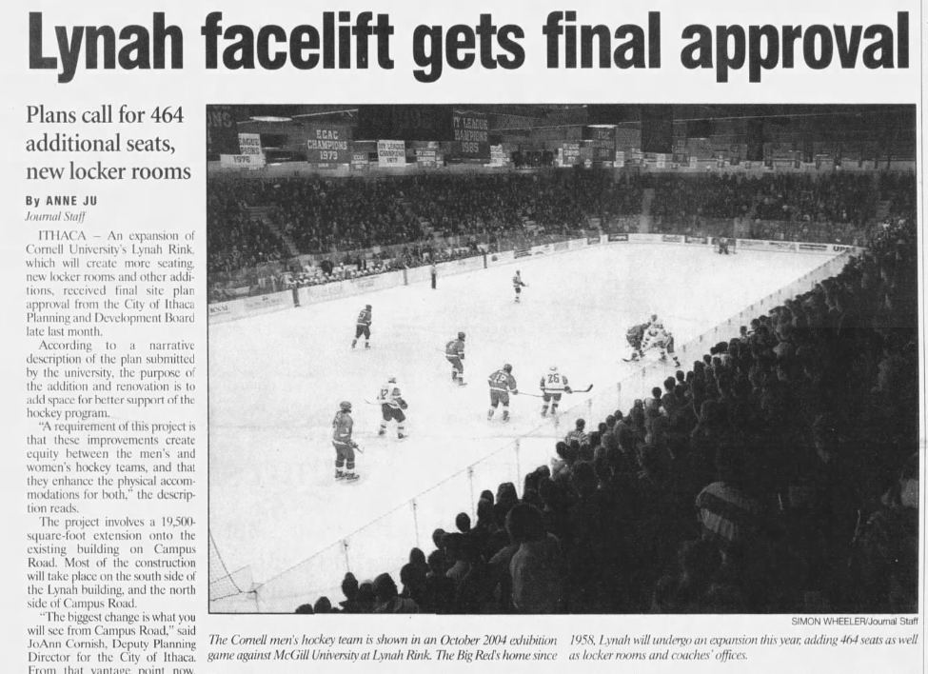

Slide 13
Though the core of the building has remained the same and the team’s championship banner hangs from the rafters, the stadium has certainly changed: the ice that the 1970s team played on is long gone.

Slide 14
A similar change happened in Providence, RI, which is where the Icemen played their next game of the season, at Brown.

Slide 15
This stadium was constructed in the early 1960s, and, like Cornell in the 2000s, underwent changes that increased capacity and generally renovated the stadium to have a more modern feel.

Slide 16
The same simple renovations are unseen in Boston Arena, which hosted Cornell’s fifth game of the season, against Boston University. Firstly, in 1979, the stadium was purchased by Northeastern University, and renamed to honor their chairman.

Slide 17
The transfer of ownership and subsequent name change is one of the more blatant transformations that has happened to the 1970’s stadiums, and while the team technically can’t say they beat Boston University in Boston Area, the stadium remained the same for the most part through the years, excluding the standard renovations that you’ll soon come to expect as we go on to more stadiums.

Slide 18
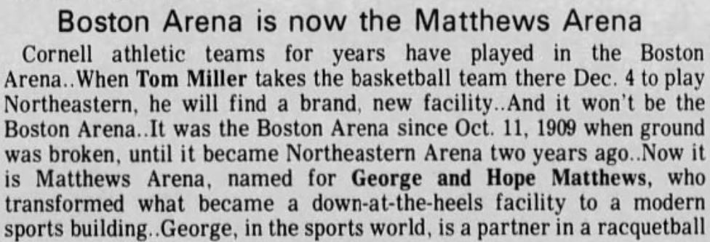

Slide 19
At least that would’ve been the case until 2024, where Northeastern opted to demolish the stadium and rebuild it in the future, due to structural faults uncovered in the surrounding area that made the stadium unsafe in certain areas.

Slide 20
While the demolition hasn’t happened yet, it’s perhaps the most recent instance of time leaving Cornell Hockey in the past.

Slide 21
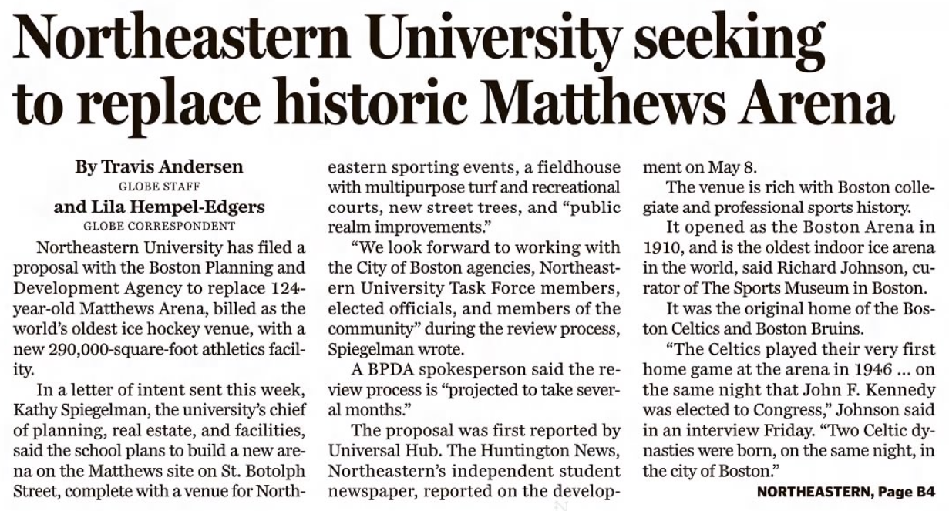

Slide 22
Big Red plays again in Lynah Rink for their 6th game of the season, beating out Yale, 8-1. They’re now 6-0 as they head over to Canton, New York to play St. Lawrence.

Slide 23
It’s the same deal with renovations here, with one slight exception. As it was announced that the stadium was going to be upgraded in 2018, the university was careful to mention that the “classic” wooden bleachers were to remain.

Slide 24
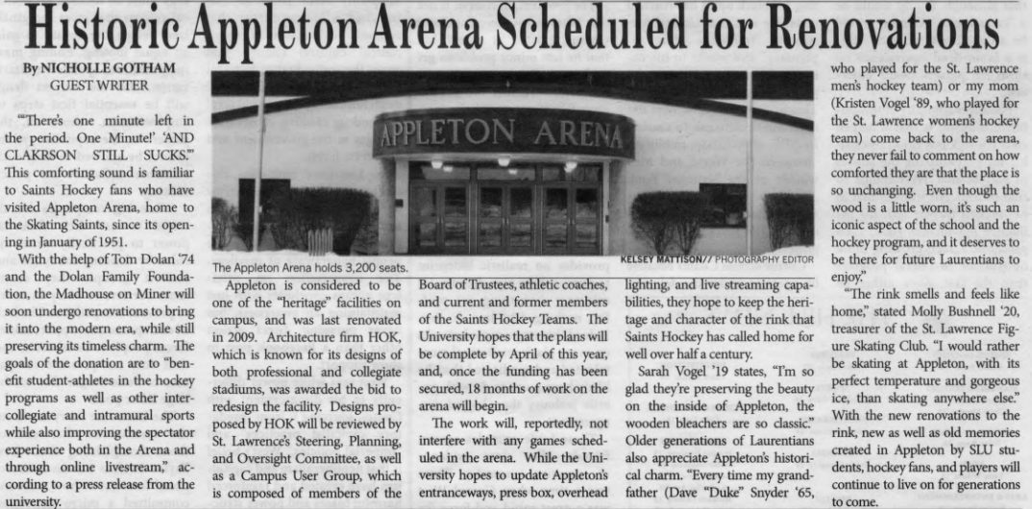

Slide 25
Maybe it’s looking too far into a PR team’s words, but there’s something sweet about that.

Slide 26
Even though so much has changed since the stadium was created in the 50s, it's pleasing to know that at least for one game that the 1970 team played, history has been preserved.

Slide 27
Cornell then traveled 400 miles south to New York City for the ECAC Holiday Tournament.

Slide 28
In The City, they played in the famed Madison Square Garden, which is by far the biggest, and as a consequence, one of the most changed stadiums on their path to the championship.

Slide 29
Not much needs to be said about the changes that happened to MSG. The images of the stadium in 1970 compared to now speak for themselves.

Slide 30
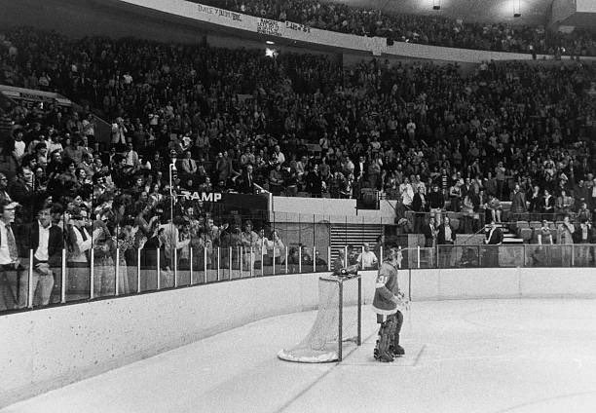

Slide 31
Following 9-0 and 7-2 victories in MSG, the team sat at nine wins heading into the Syracuse Invitational. As a part of this tournament, the team played in what’s now called the Upstate Medical University Arena.

Slide 32
But like the Boston Arena story, the building wasn’t called Upstate until just recently, when the stadium formerly known as the Oncenter War Memorial Arena sold its naming rights to Upstate Medical University for just under $3 million.

Slide 33
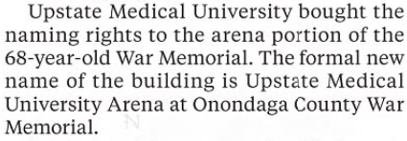
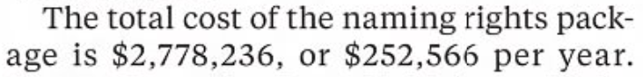

Slide 34
The contractual nature of this type of negotiation is interesting. After the remaining 5 years run out on Upstate’s naming rights, who’s to say what happens to the stadium then?

Slide 35
If it changes names again, it’s just another ring that people have to jump through to get to the history of Cornell’s Cinderella story.

Slide 36
If it changes names again, it’s just another ring that people have to jump through to get to the history of Cornell’s Cinderella story.

Slide 37
Though commercialization is something that we’ll soon see more of, we’re back to regular, University-owned stadiums in Boston and Toronto.

Slide 38
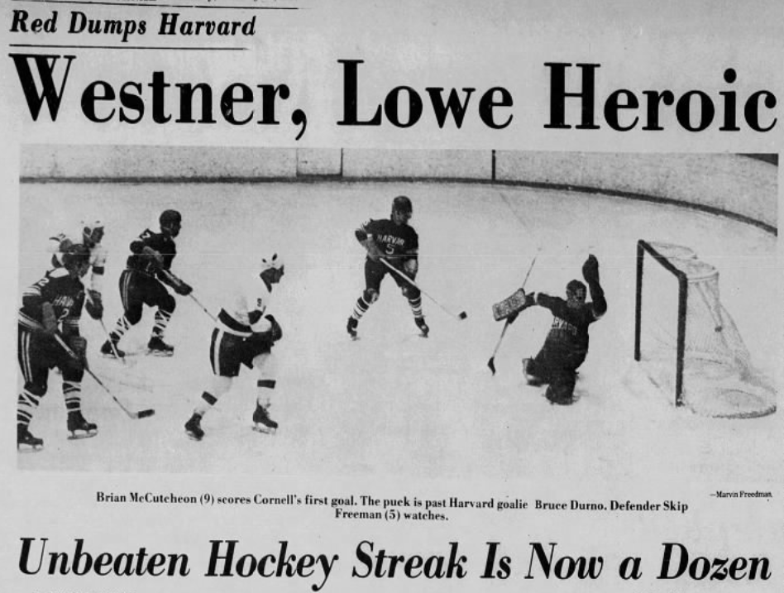

Slide 39
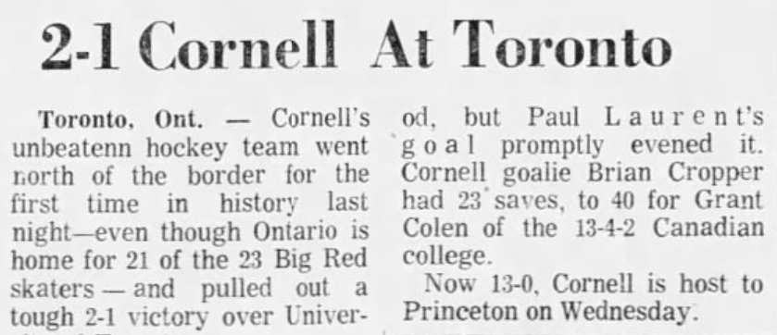

Slide 40
In case you’ve lost count, that’s now 13 wins for Cornell, with no losses. They finally return home near the end of January, to face off against Princeton, who they stomp 7-1.

Slide 41
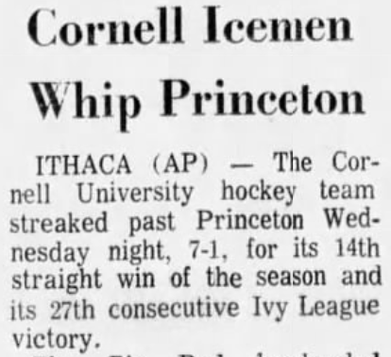

Slide 42
At this point, this is already Cornell’s best season in team history. The previous two years, though they finished first in the division, they had blemishes on their record going into February.

Slide 43
To the fans at the time, this season was unheard of, just like it still is to us in 2025.

Slide 44
Big Red’s success continues with a win over Yale in New Haven, followed by 3 more consecutive wins back in Ithaca.

Slide 45
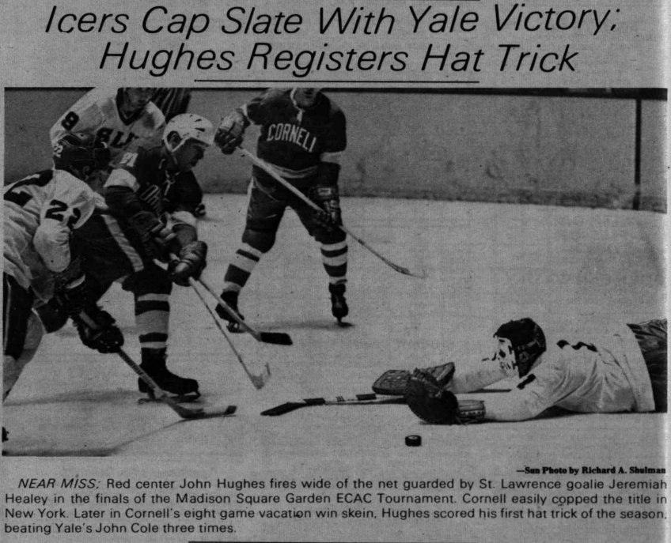

Slide 46
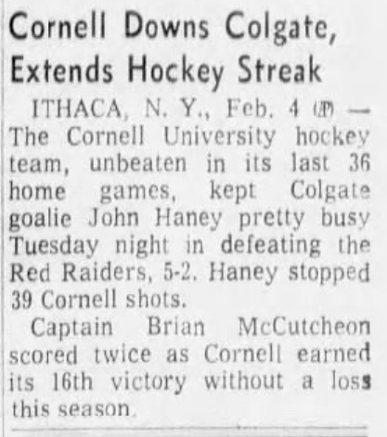

Slide 47
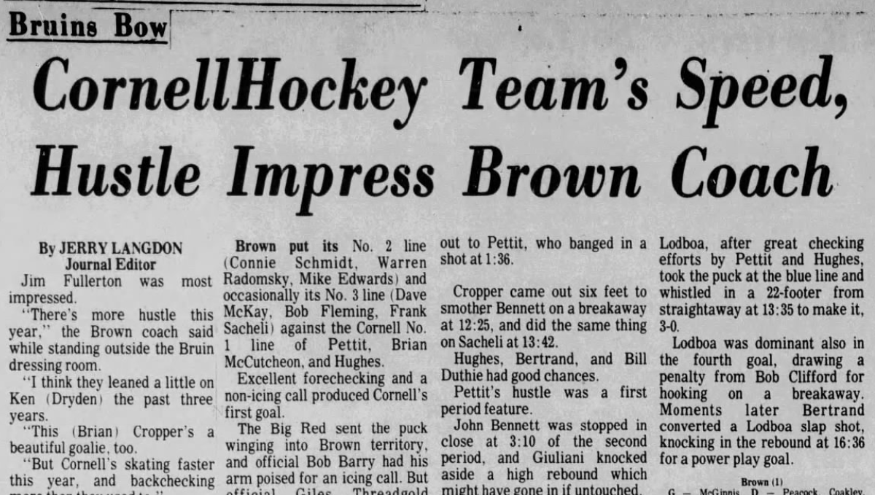

Slide 48
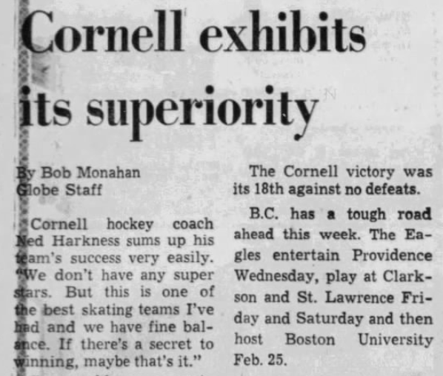

Slide 49
By now, it seems like this is going to be a season that is impossible to forget. Cornell is completely dominating their opponents, and is now up to an 18-0 record.

Slide 50
But the next game, against the University of Pennsylvania, proves how over the years, our memories may become hazy.

Slide 51
The game was played in Cherry Hill Arena in New Jersey, which was a terrible facility.

Slide 53
In 1978, perhaps to distance themselves from an unsatisfactory past, the stadium was renamed to “The Centrum”, but that change, although adding another layer of depth to the 1970 team’s story, did not end up rehabilitating the facility’s tarnished reputation, and in the following year, the stadium was demolished.

Slide 54
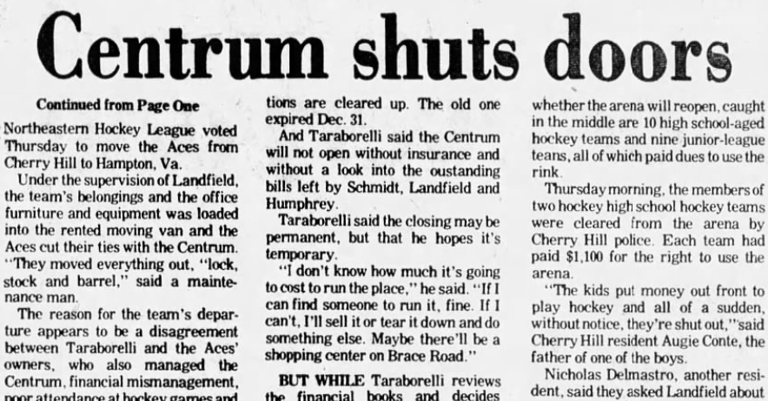

Slide 55
In its place:

Slide 56
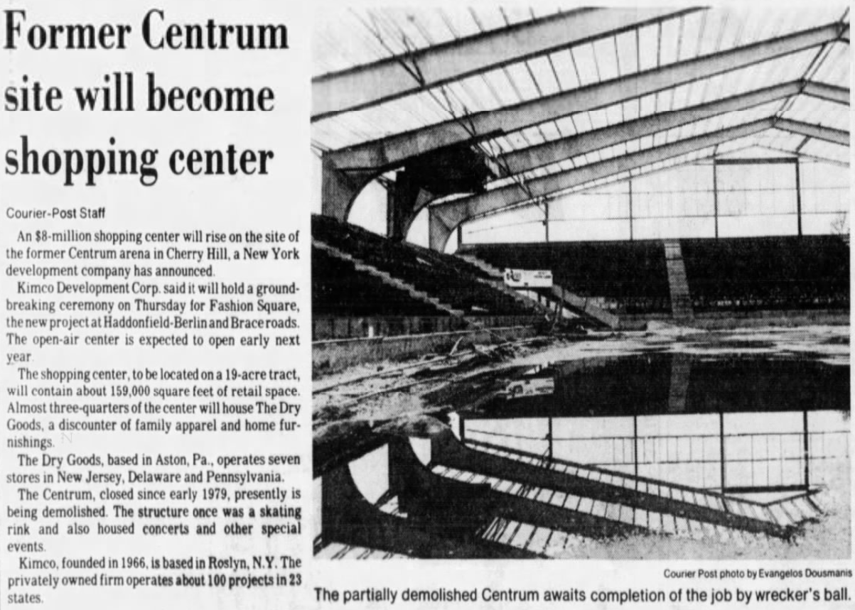

Slide 57
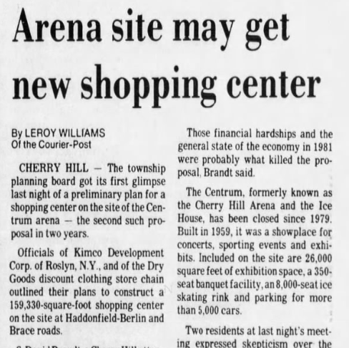

Slide 58
No hockey will ever be played here anymore. The stadium is gone.

Slide 59
Even if the 1970 team set historic records, as history passes, it becomes harder and harder to appreciate what they actually did.

Slide 60
Though not quite as harsh as the Cherry Hill story, Cornell’s next game is played at Dartmouth, whose stadium is also no longer existent. They played in Davis Rink, which was abandoned in 1975 for the Thompson Arena and demolished in 1985 to make room for the Berry Sports Center.

Slide 61
What’s unique about Davis Rink was that it was open-air. When Cornell played on that ice in 1970, they were exposed to the elements - something that’s not done at the NCAA level anymore, outside of select exhibition games.

Slide 62
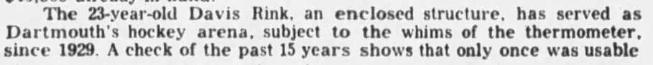

Slide 63
Alas, the uniqueness of Davis Rink proved to be its limiting factor, as the seating arrangements for an open-air stadium were lackluster for a growing sport in Hanover.

Slide 64
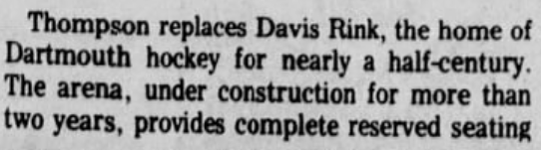

Slide 65
When Thompson opened, it allowed for an additional 1,500 seats. While it was a change needing to be made as the sport modernized, a part of Cornell’s historic season was left behind in Davis.

Slide 66
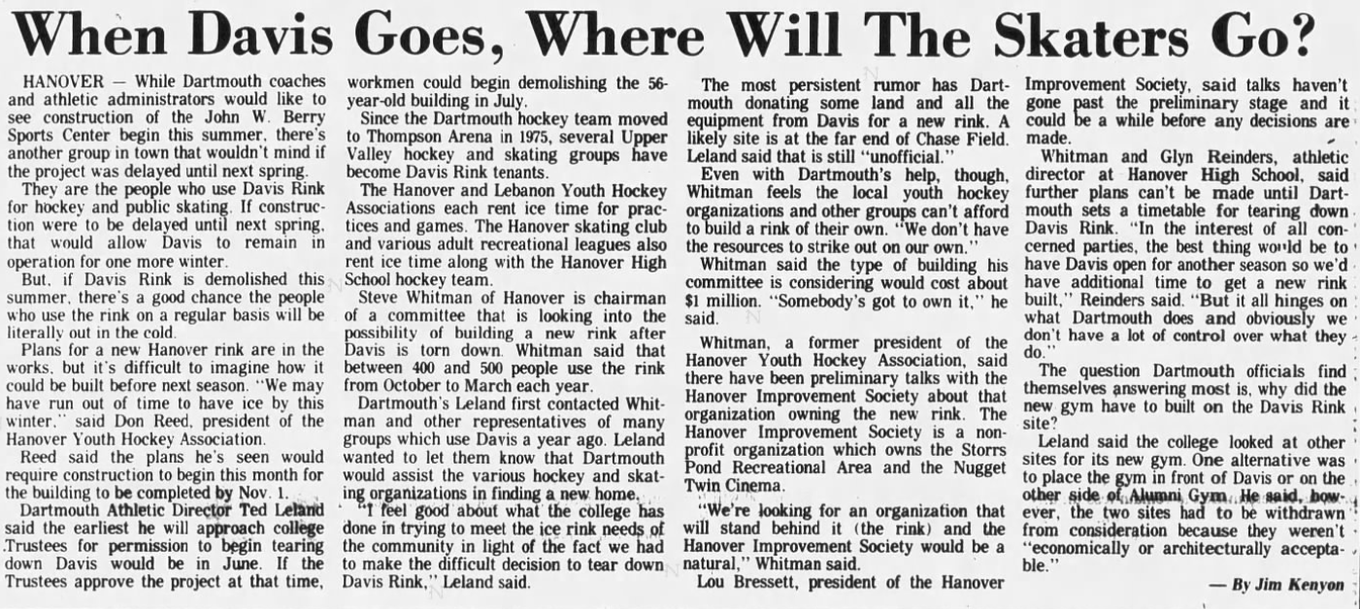

Slide 67
It was back to Lynah for three of the last four games of the season, with the final game of the season being played at Princeton in Hobey Baker Memorial Rink, which has undergone the usual renovations in the early 2000s.

Slide 68
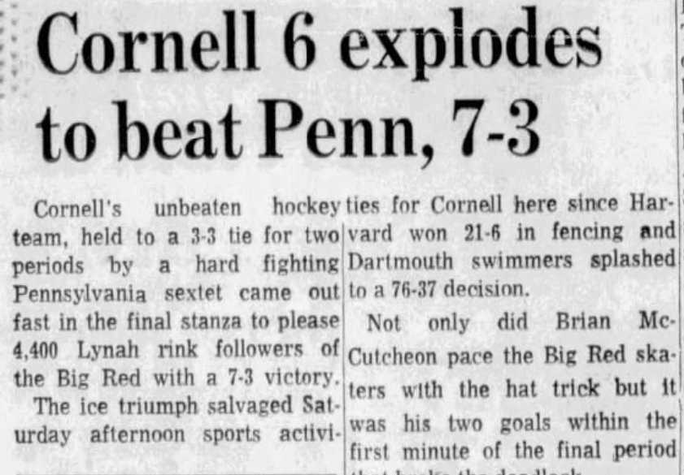

Slide 69
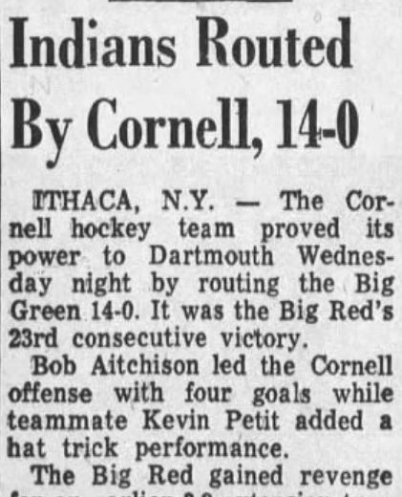

Slide 70
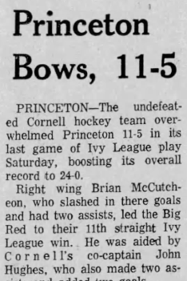

Slide 71
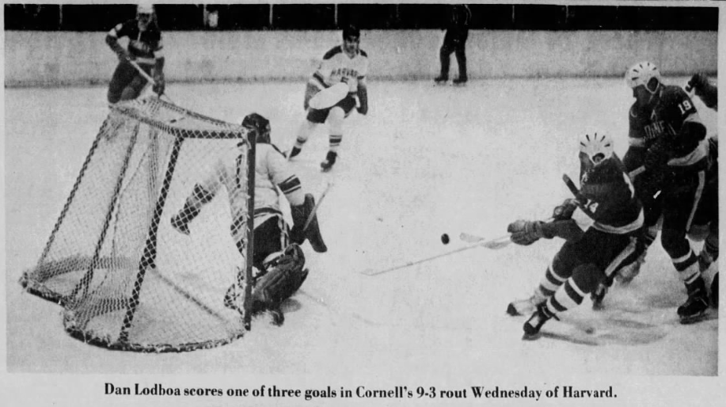

Slide 72
With those four games completed, Cornell finished the regular season with an unprecedented 24 wins and zero losses.

Slide 73
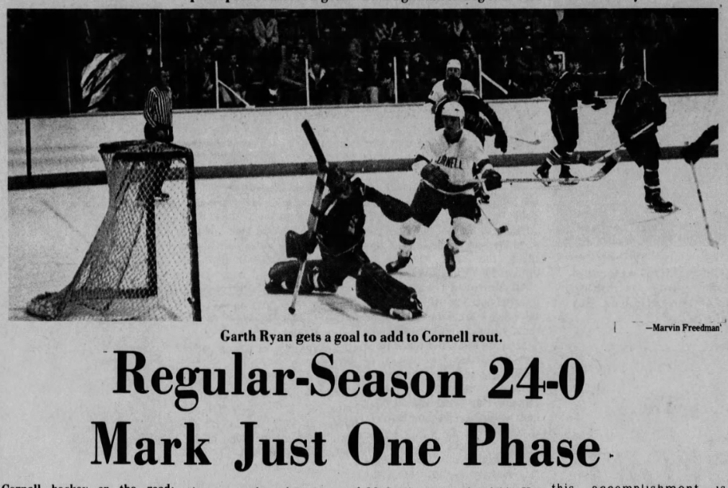

Slide 74
Now, the real season starts. In the ECAC Hockey Championship, Cornell was at home against St. Lawrence for the quarter finals. As you can probably guess, it was an easy win for the team.

Slide 75
Now, the real season starts. In the ECAC Hockey Championship, they were at home against St. Lawrence for the quarter finals. As you can probably guess, it was an easy win for the team.

Slide 76
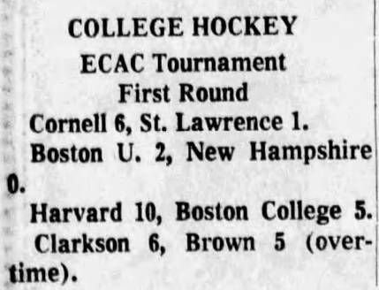

Slide 77
From here on, the games would be more anxiety-ridden.

Slide 78
Not for us, though, since we know how this story ends. In both the semifinal and the final of the division tournament, Cornell played in Boston Garden - a stadium that was demolished in 1988 in favor of its present-day successor, TD Garden.

Slide 79
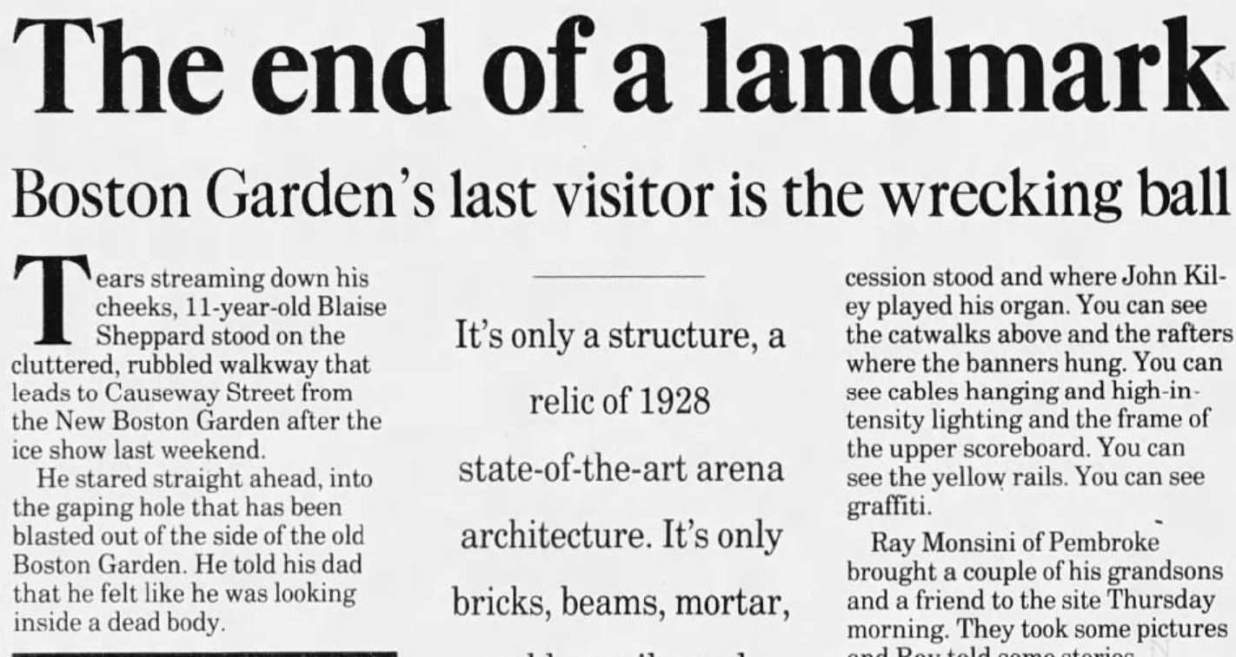

Slide 80
Even at the highest level of collegiate play, no individual stadium is safe from being forgotten.

Slide 81
Advancing to the NCAA tournament, there were two more games in Cornell’s historic season, both to be played in Jack Shea Arena in middle-of-nowhere Lake Placid.

Slide 82
This place holds some of hockey’s most prized memories, notably, the 1980 Olympics’ “Miracle on Ice”, which is arguably the greatest moment in American hockey history.

Slide 83
It’s fitting that all of that rich history occurred in such a random location. Yes, the Arena has had its fair share of renovations and even had its name changed to the “Olympic Center”, but at its core, it’s still there, much like those memories.

Slide 84
When Cornell hockey won the championship, it was national news, with newspaper placements across the country, of course including Ithaca, New York.

Slide 85
When Cornell hockey won the championship, it was national news, with newspaper placements across the country, of course including Ithaca, New York.

Slide 86
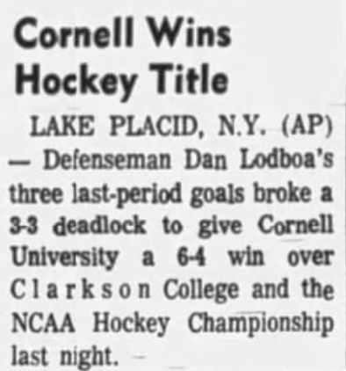

Slide 87
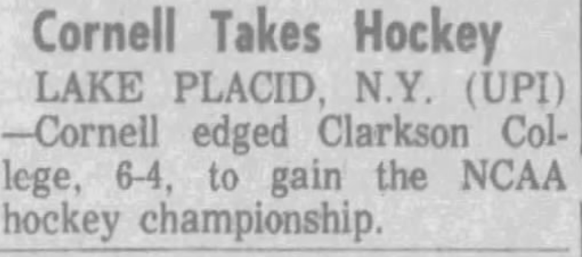

Slide 88
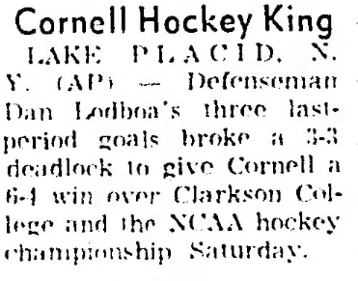

Slide 89
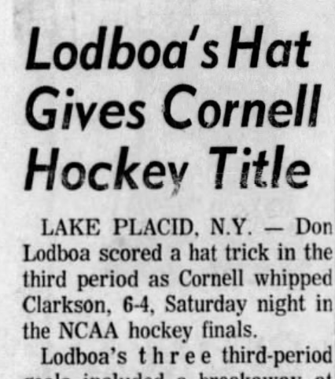

Slide 90
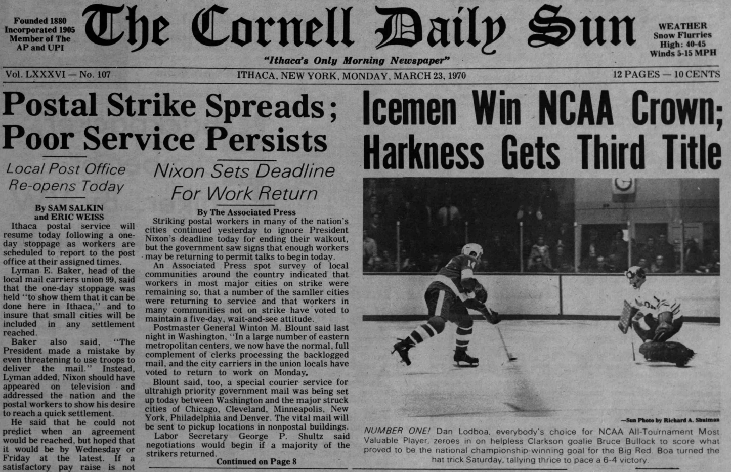

Slide 91
While it’s difficult to compare anything to the “Miracle on Ice”, there are similarities in Cornell’s undefeated season.

Slide 92
It’s something we’ll likely never see again in our lifetimes, and for the youth, it’s something they’ll never get to actually witness, but still, it’s something that lives on in Lake Placid.

Slide 93
But even if all those stadiums were renamed, renovated, or demolished; those newspapers buried further into the archives or lost on the internet, the memories still live on.

Slide 94
It might be harder to visualize, but that emotion and excitement is still there.

Slide 95
Even if you never saw the team play, just reading about their dominance makes you understand their story.

Slide 96
There’s a newspaper that was published after the Boston Garden was demolished.

Slide 97
Kennebec Journal, Sunday April 12th, 1998, Page 28, from Augusta Maine.

Slide 98
That copy of the paper will probably never be read again and the author has likely retired or passed.

Slide 99
In that paper, there’s an article about the impact of the Garden and a good quote.

Slide 100
